Slide 1
Project Name : Montajaty
Company : AST
Team Members:
1-Team Leader : Ahmed Wael => Handling the all Project With Firebase and
In charge of The Way of payment , Admin Mode And the all project .
And I give my team the following tasks.
2-Mohamed Adel Mohamed => Tasks(Login and Register Screen With Firebase)
=> ((UI) Forget password Screen , Profile and cart screen , Requests and Confirm Screen in admin).
3-Abdallah Selim => (Edit and delete Screen In admin )And (Home with product details ,favourite screen)

Slide 2


Slide 3


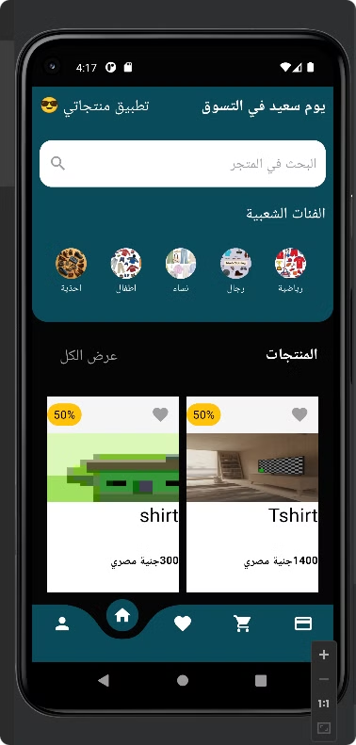

Mobile E-commerce App Presentation
Welcome to our presentation on the cutting-edge mobile e-commerce app designed engaging shopping experience.
by Mohamed Adel

Slide 4


App Overview
1
User-Friendly Interface
2
Personalized Recommendations
3
Seamless Shopping Experience
The app prioritizes a simple and intuitive design, making it easy for customers to navigate and find what they need.
The app uses intelligent algorithms to suggest relevant products based on user preferences and past purchases.
The app offers a smooth and enjoyable shopping journey, from product discovery to secure checkout.
4
Admin-Mode
Admin can see the required product and accept it ,can delete or edit products from app and can add more products

Slide 5
Key Features
Product Browsing
Search Functionality
Browse a wide selection of products categorized by type, and price.
Quickly and easily find specific products using a powerful search bar.

Slide 6

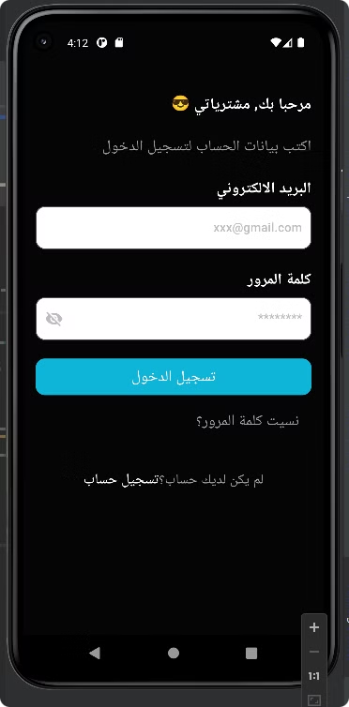
Login
you can log into our app easily by your email and password.

Slide 7

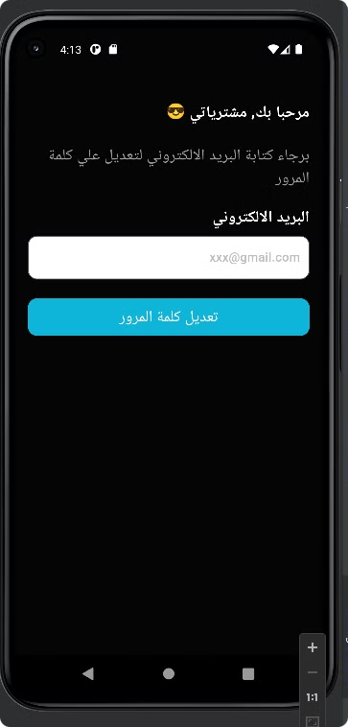
Forget Password
And if you forget your password , we will help you to update it.
you will enter your email and we will send you to change your password.

Slide 8

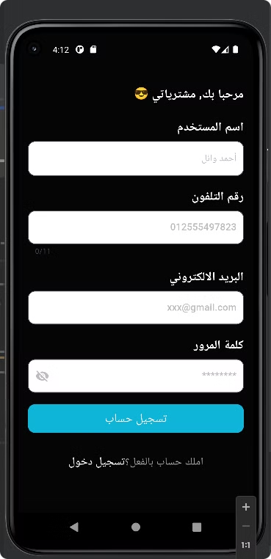
Register
And if you don't have an email we will help you to create one easily.

Slide 9
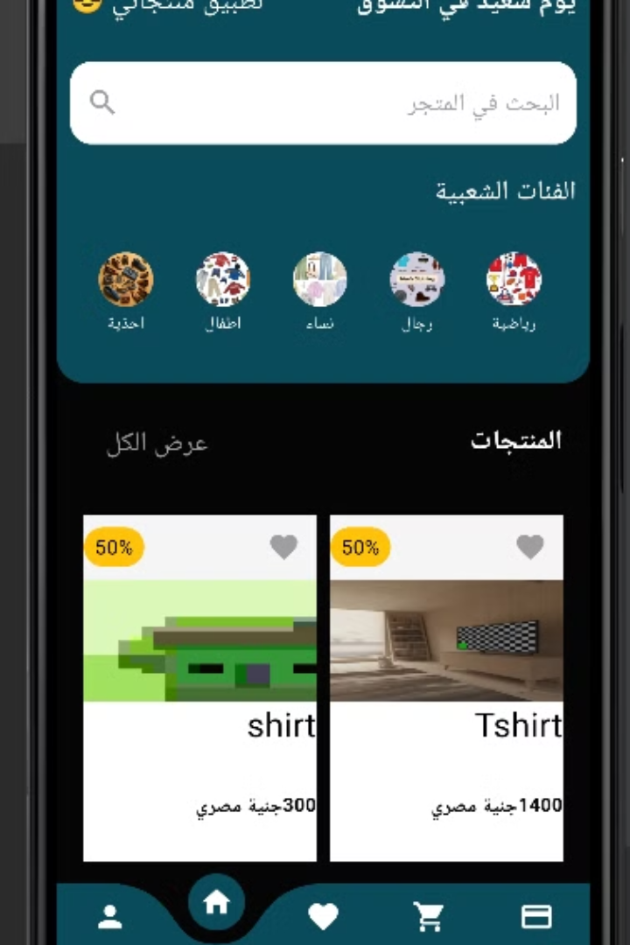




User Interface and Navigation
Home Screen
Displays personalized recommendations, featured products, and ongoing promotions.
Categories
Browse products by category, including shoes, men, women children, and more.
Search
Quickly find specific products using a search bar with auto-suggestions.
Account
Manage your profile, orders, payment methods.

Slide 10

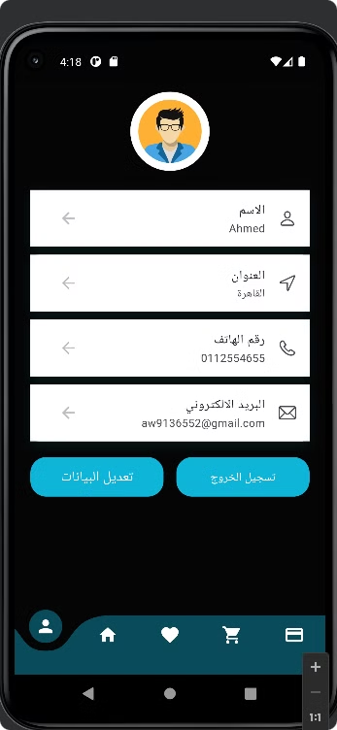
Your Profile
It has your Name , Address ,Phone Number and Email.
You can update your profile
you can log out from app from here and it will go back to login screen.

Slide 11
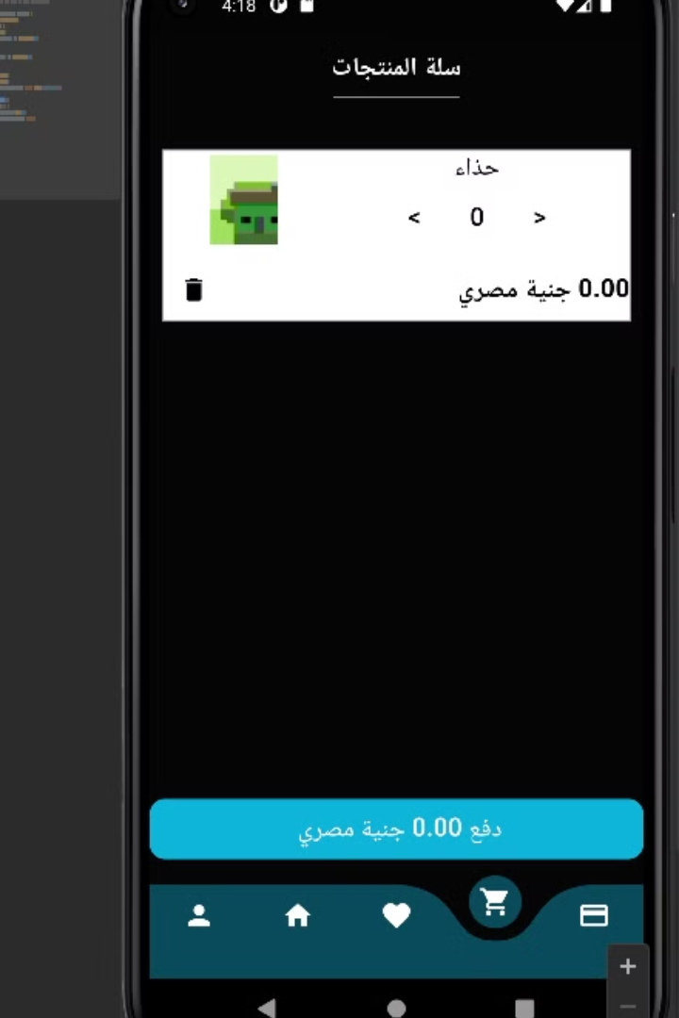
Shopping Cart and Checkout
1
Add to Cart
Add products to your cart with a single tap and view your total amount.
2
Checkout Process
you can increment and decrement the number you want from this product.
3
Order Confirmation
You can confirm the order with The best way for buying and enter your number.

Slide 12

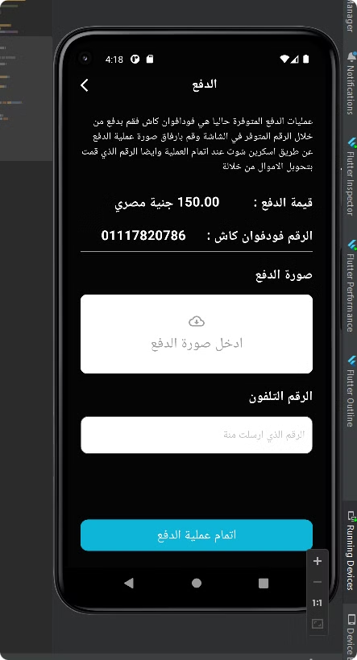

Payment Options and Security
Digital Wallets
For Now you can only pays by vodafon cash.

Slide 13

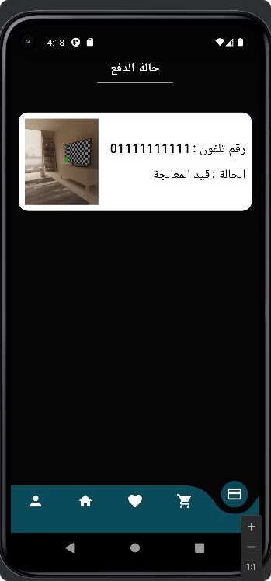
Payment Status
The user is waiting for the admin to accept his requist to buy a product

Slide 14

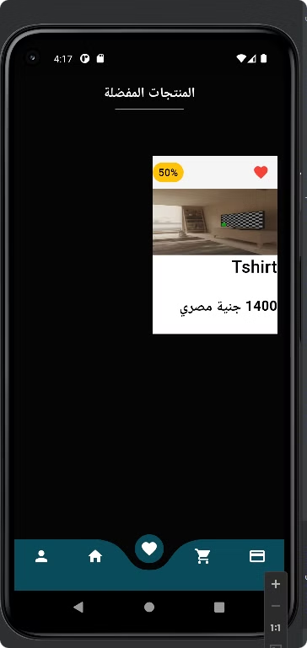
Favourite Screen
You can choose your favourite product and by default it will be added to favourite screen.

Slide 15

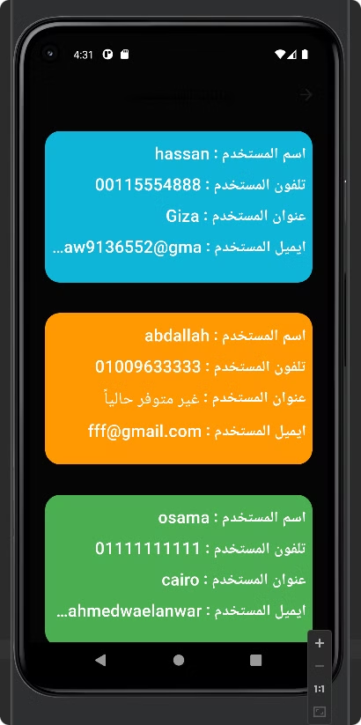
Admin
Here are the admins of the app who can add products , edit or remove products and check requists.

Slide 16

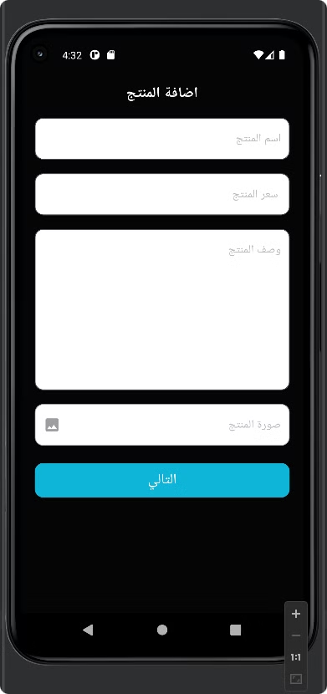
Add Products
He can add any product ha want with specific categories like
(product name , product price , product description , product image).

Slide 17
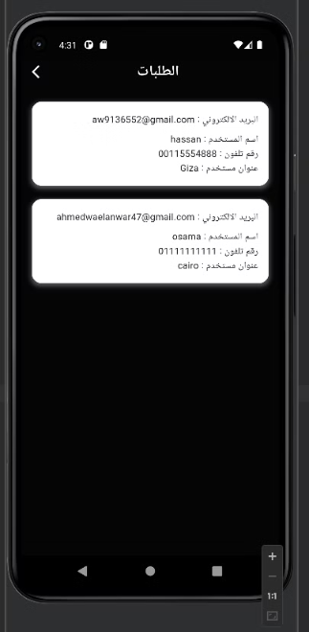
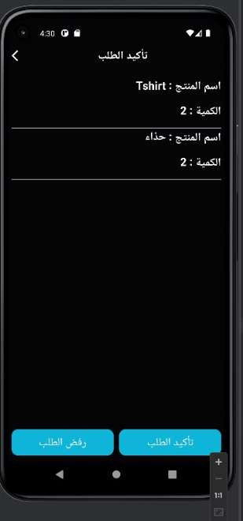
Check Requists
He can see all requists that he got from users.
Then he can accept or refuse the requist.

Slide 18

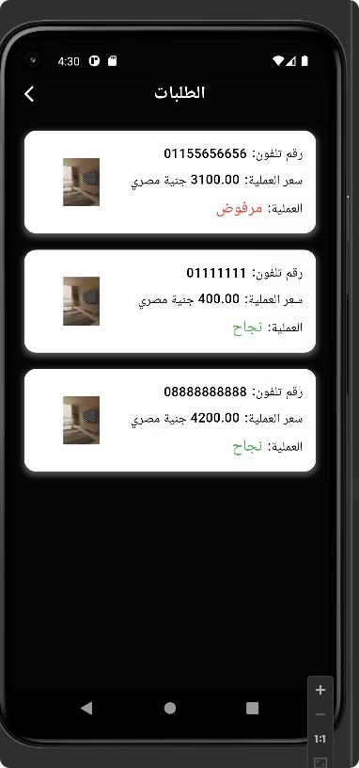
Requists Results
Here we show if requist accepeted or not.

Slide 19
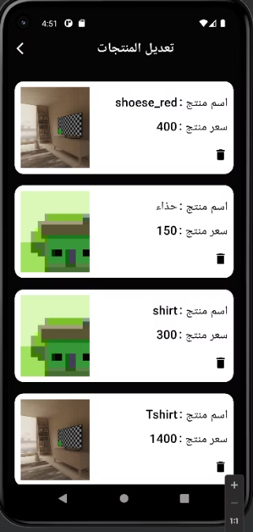
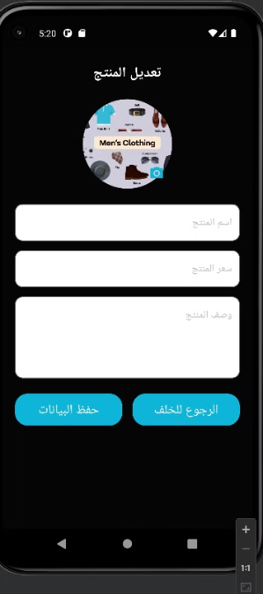
Update Or Delete
Here i can find my products and i can choose between if i want to delete it or update it.
Now admin can update any product he wants.

